Slide 1

Analysis of Barriers to Application for WSF Student Aid
Charlie Gardner
March 6, 2021
MSDS670 – Final Project
Video Presentation

Slide 2
Introduction to Data
Throughout class, I have explored different racial equity implications of the Winston-Salem Foundation’s student aid program. Previously, I have identified that while there are racial disparities in student aid awarded especially for donor-designed scholarships, much of these disparities arise from a disproportionally large number White applicants.
For final this week, I will look more specifically at potential barriers that depress the number of BIPOC students applying. I will narrow my focus to Forsyth County applicants and will also incorporate US Census Data at the tract level.

Slide 3
Methodology
In addition to WSF data on student applicants, I used variety of resources from U.S. Census, including shapefiles of the 93 tracts in NC/Forsyth County, geocoding services to convert addresses to coordinates, and data tables from ACS 2019 5-year demographic estimates.
I also used different methods to process the data:
Excel’s tables and pivot tables to tabulate, sort, and filter applicant table to both create bar plots and to upload into Pandas data frames.
Matplotlib and Seaborn libraries to generate choropleth maps and then overlaid scatterplots and heatmaps.

Slide 4
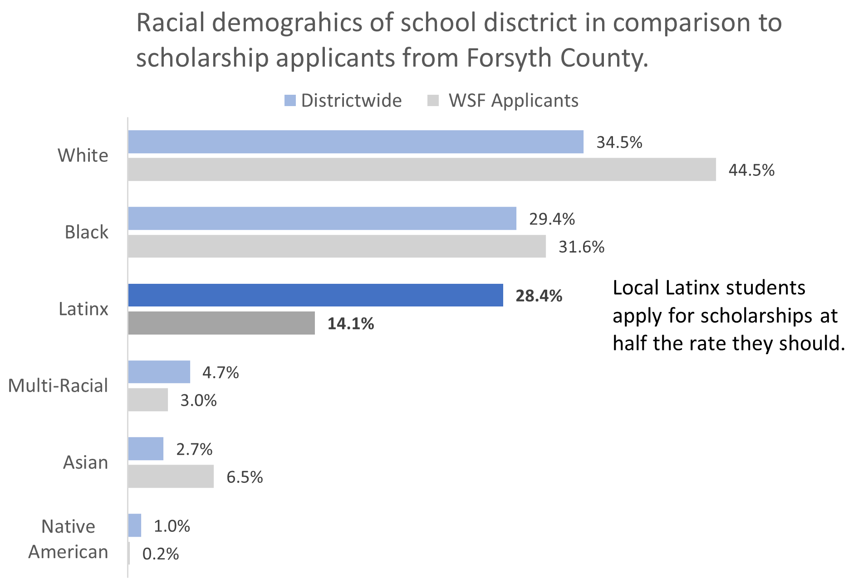
Research Question: What barriers do Latinx students face when applying for WSF scholarships?
When just looking at the WSF scholarship applicants from Forsyth County, the racial disparities are eliminated for all groups except Latinx students.
If we use the local school district’s racial demographics as benchmark, Latinx students should be applying for scholarships at twice their current rate.

Slide 5
Guidance counselors and friends/family refer the most students to WSF scholarships
The two primary ways that applicants hear about WSF scholarships are from high school guidance counselors and from friends and family.
In both categories, Latinx applicants are underrepresented.
They comprise only 16% of those who indicated they learned about the scholarship program through a guidance counselor, and only 10% from friends and family.
White students are most likely to hear about the scholarships through guidance counselors or from a friend/family member.

Slide 6
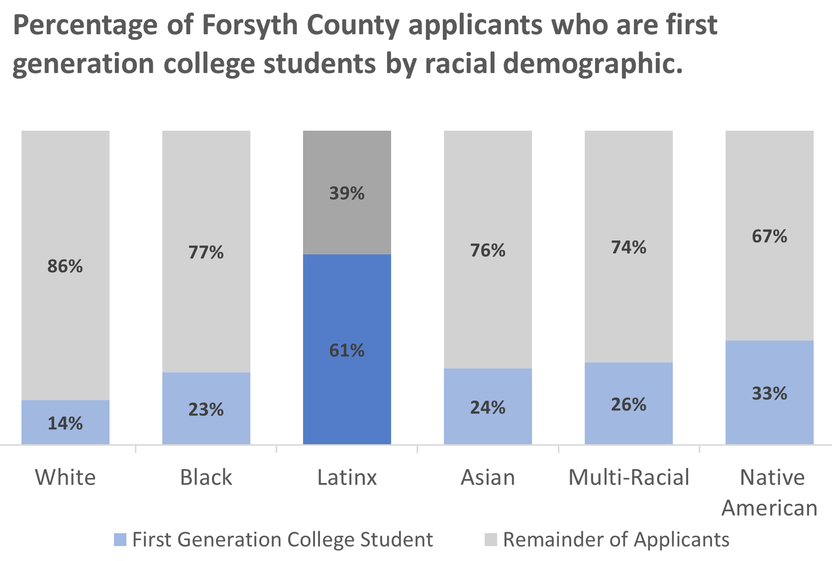
Most Latinx applicants are first generation college students
Of the 629 Forsyth County applicants, 159 of them are first generation students, which is about 25%.
Latinx are overrepresented in this classification, with the 61% of applicants being first generation college students.
White applicants are most likely to have family members who have been to college before (86%).

Slide 7
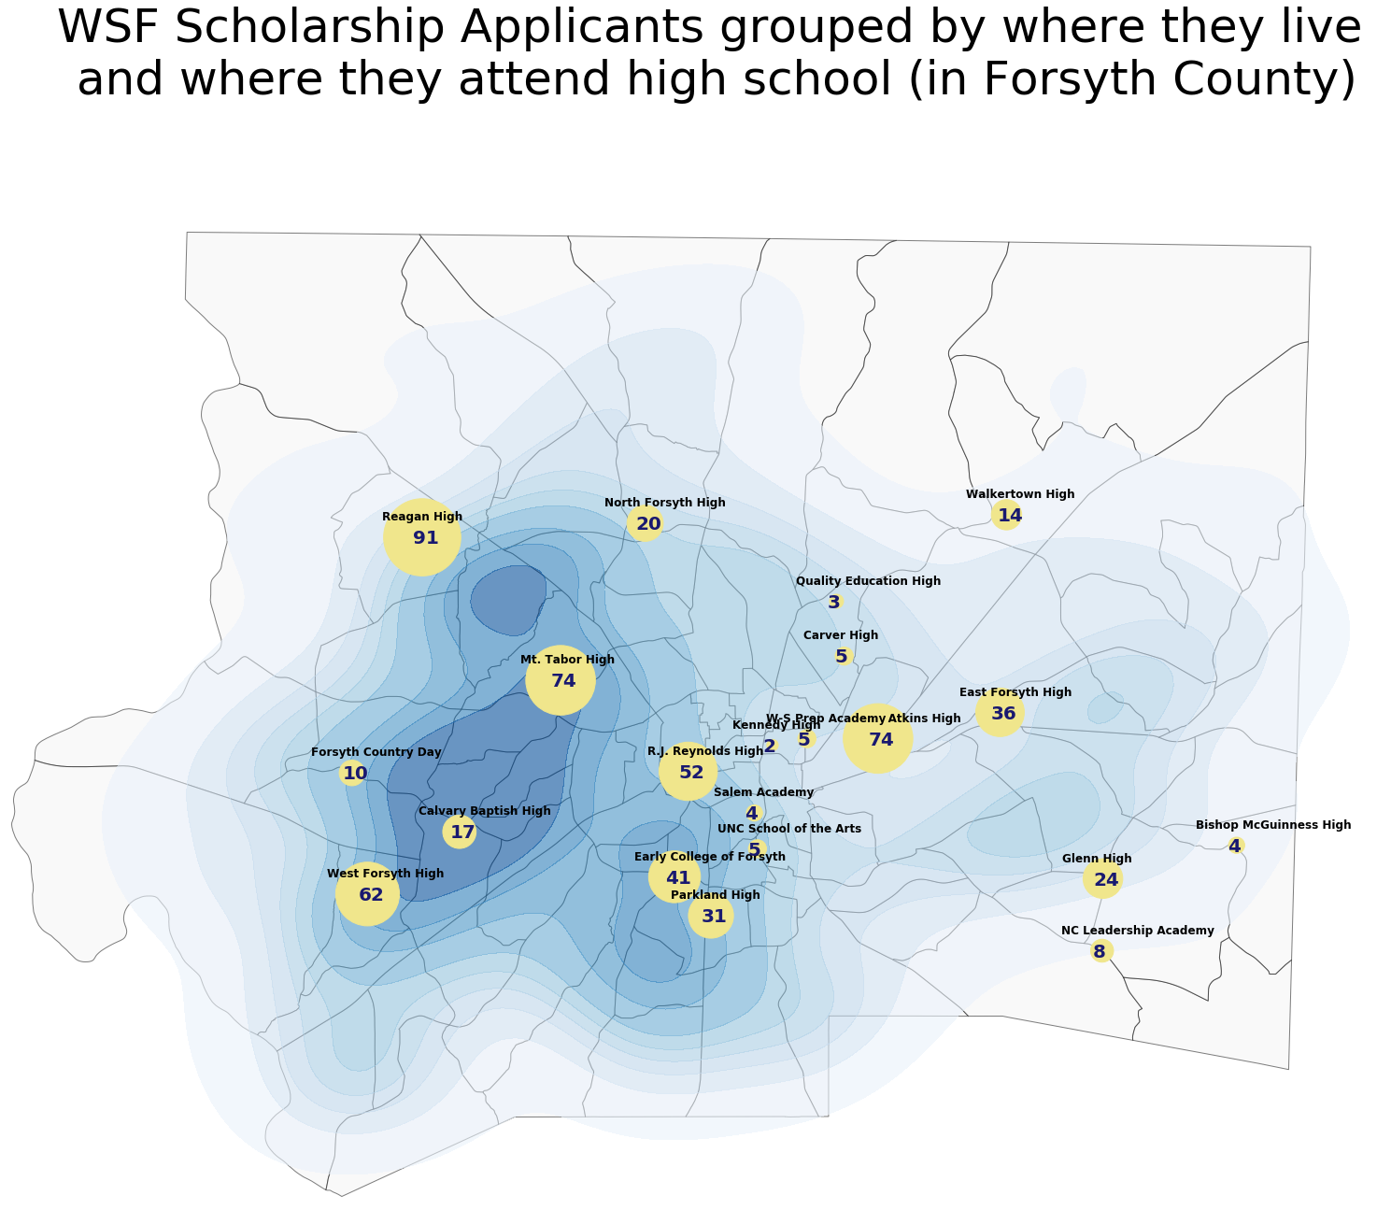
Applicants are clustered in West side of Forsyth County
Most local applicants live clustered in the Western side of the county.
The high schools that have the most applicants are also in the Western side, except for Atkins High.
All high schools with single digit applicants (8 in total) are in the Eastern side.

Slide 8
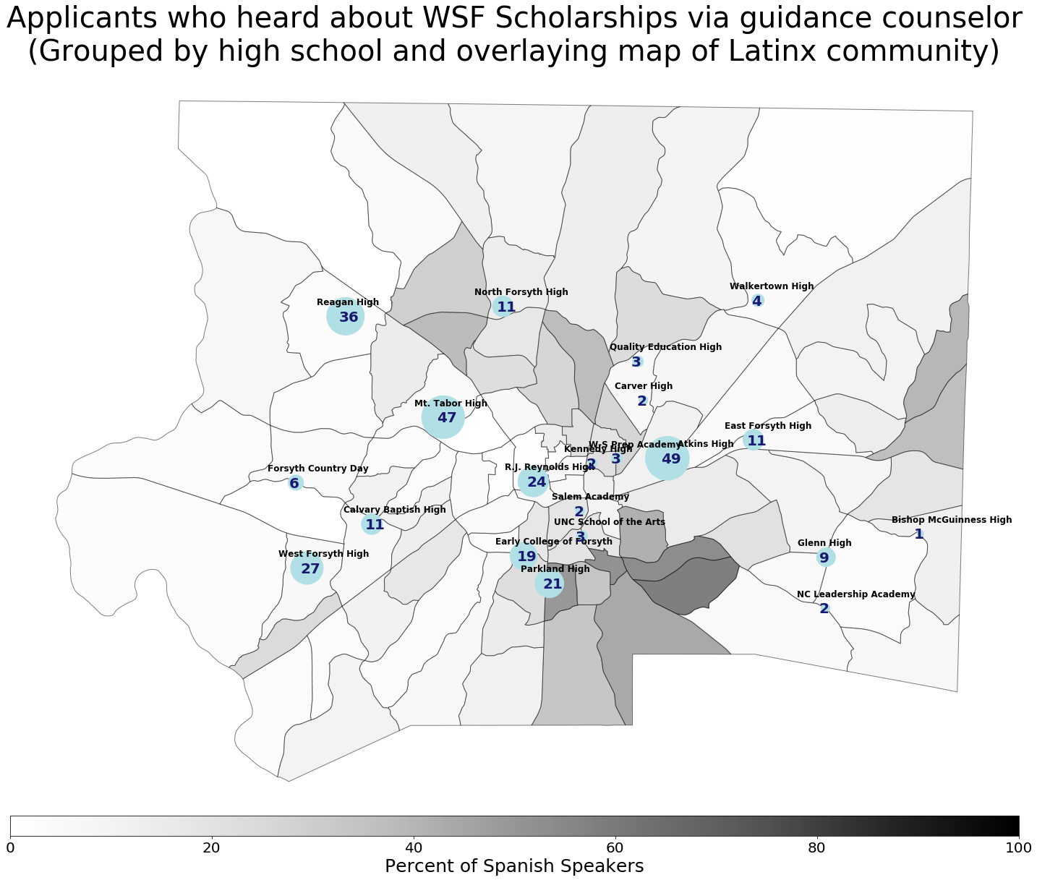
Highest referring guidance counselors work in high schools in/near neighborhoods with few Latinx residents
In Forsyth County, the majority of the Latinx community lives in the Southeast side. With some neighborhoods being comprised of nearly 50% of Latinx residents.
Guidance counselors in schools that are in/near neighborhoods with high percentage of Latinx students refer the fewest number of applicants to WSF scholarships.
The guidance counselor with most referrals is at Atkins High, which is on the East side.

Slide 9
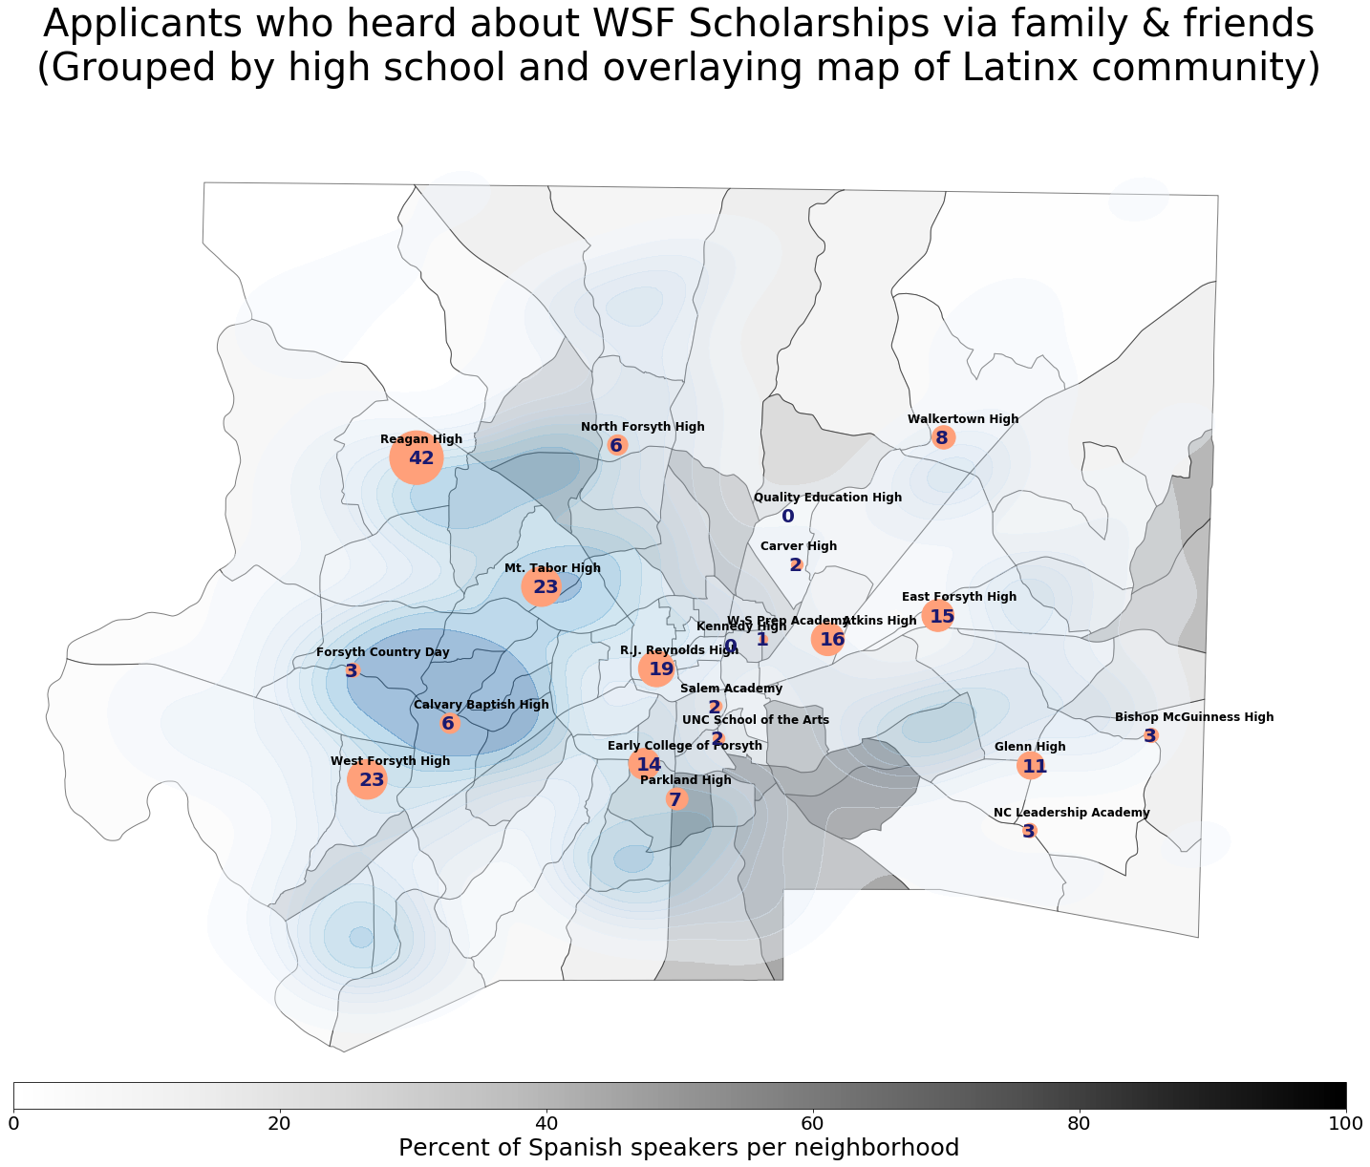
Few applicants had friends/family lived in neighborhoods with a high percentage of Latinx residents
The majority of the WSF scholarship applicants who were referred by friends and family live in neighborhoods with few Spanish speaking residents.
Several high schools in/near neighborhoods with large Latinx populations did have any applicants that heard about WSF scholarships through friends and family.

Slide 10
Conclusion
White students are the least likely to be first generation, most likely to hear about the opportunity through guidance counselors or through a friend/family member, and most likely to apply for scholarships. The inverse is true for Latinx students.
Social networks are very important for encouraging students to apply for scholarships. Barriers to application include where one lives, which school someone attends, and which language is spoken at home.
Recommended actions to increase Latinx student applications include targeted outreach to guidance counselors at their neighborhood high schools and developing marking material in Spanish to engage the families of students and Latinx community overall.

